Slide 1
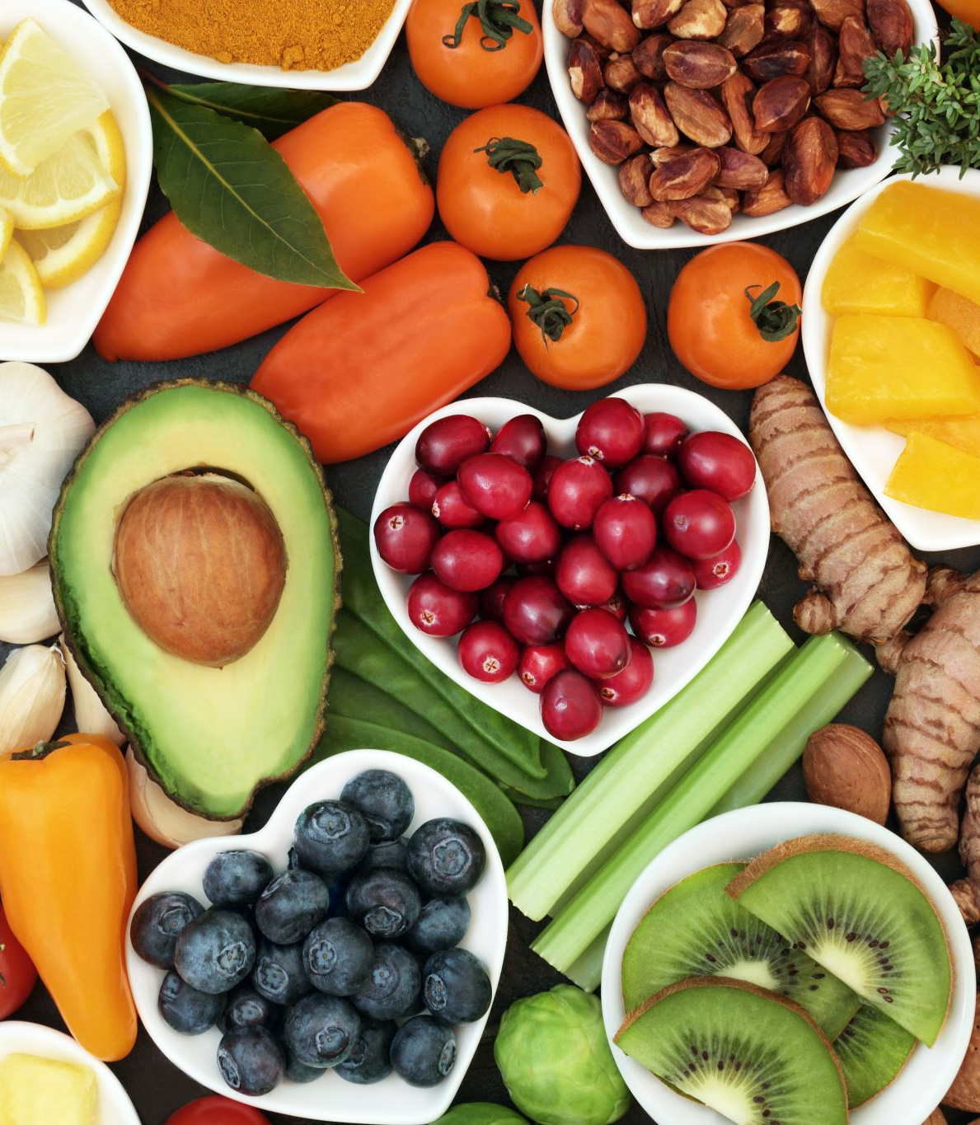
Deep neural network for food image classification and nutrient identification - A systematic review
Presented By
Pasupuleti Rohith Sai Datta

Slide 2
Introduction
This paper explores how technology impacts our health, especially using smart computers to analyze food from pictures.
Technology can benefit us by improving communication but warns against excessive social media or phone use leading to issues like sleep problems, sadness, or weight gain.
Researchers reviewed many articles on how technology helps us understand our food better.
Out of 771 articles, 56 were most useful. These articles discuss computer recognition of food in pictures and determining food nutrients.
The paper emphasizes the importance of healthy eating and how various diets can keep us healthy.

Slide 3
Introduction
The paper highlights that our bodies need nutrients like carbohydrates, protein, vitamins, and minerals to stay healthy.
Diets like the Very-Low-Calorie Ketogenic Diet and the Southern Europe Atlantic Diet can aid weight loss and promote health.
Researchers discuss using phones and devices to photograph food and analyze its contents using computers.
They employ advanced computer programs, called Deep Learning algorithms, to recognize food in pictures.
In conclusion, the paper suggests that technology can assist us in eating better and maintaining health by understanding our food better.

Slide 4
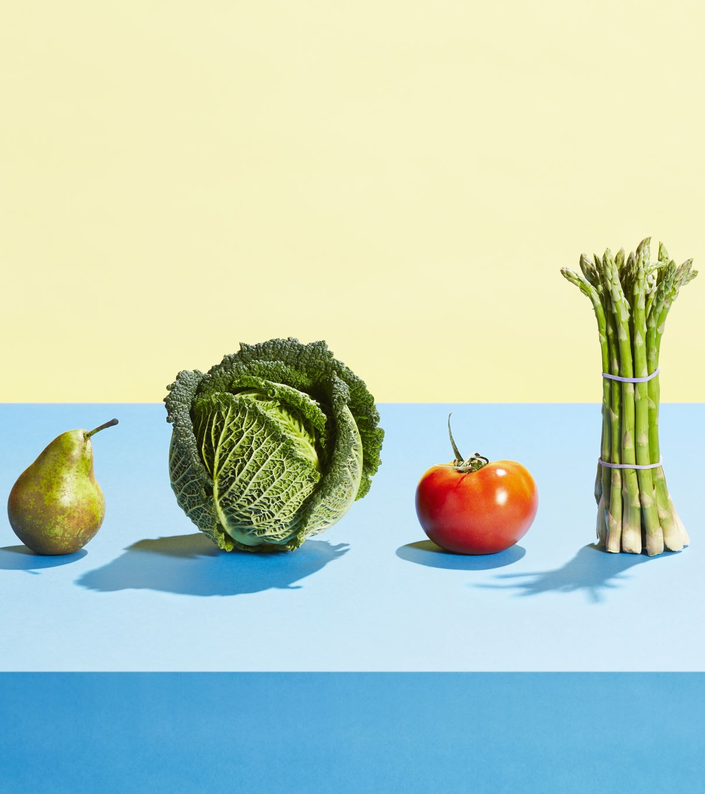
Background Study
This section examines research on AI methods for identifying food nutrients using images of food.
The review has two phases:
1. The first phase analyzes papers where the CNN model is built from the ground up.
2. The second phase looks at using the TL approach with pre-trained CNN models.

Slide 5
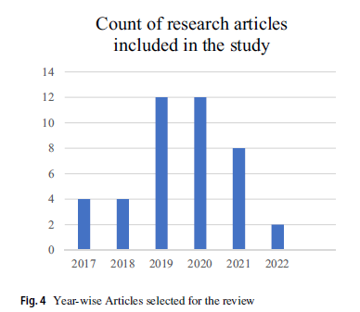
Food Image Analysis with CNN & Object Detection
Researchers are using a new technology called CNNs to better understand food images.
They've developed tools that can quickly identify food and estimate details like calories.
Some tools can recognize various foods and beverages, aiding in identifying meal contents or spotting mold on food.
These tools are continually improving and are valuable for promoting healthier eating habits and understanding different foods.

Slide 6
Role of TL in the analysis of food images
Transfer Learning (TL) is an efficient method for analyzing food images with CNN models.
Instead of building models from scratch, TL uses pre-trained models, saving time and effort.
Researchers like Tasci and Hu used TL with models like ResNet and DenseNet, achieving high accuracy in food recognition.
Qiu et al. demonstrated TL's effectiveness in predicting individuals' food intake sequences.
TL has diverse applications, from estimating calorie intake for the elderly to creating mobile apps for nutritional analysis.
In summary, TL enhances the efficiency and accuracy of food image analysis.

Slide 7
Proposed investigations
This study investigates food image analysis and various machine learning methods used for identifying nutrients.
The key aspects essential for evaluating the research study are outlined below:
1. Food Image Datasets for FIC: Examining available datasets for Food Image Classification (FIC) to understand their diversity and quality.
2. Hyperparameters Optimization: Understanding parameters like learning rate, batch size, and activation functions to enhance model performance.
3. CNN Architecture in FIC: Investigating how Convolutional Neural Network (CNN) architecture addresses challenges in food image classification.
4. Transfer Learning (TL) Strategies: Analyzing fine-tuning and feature extraction techniques in TL to improve FIC performance.
5. Performance Metrics: Identifying metrics like accuracy, precision, recall, and F1-score to evaluate FIC models.
6. Challenges in Food Image Classification: Exploring obstacles like variations in food appearance, image quality, and dataset size.
These areas stem from a thorough review of existing FIC research and form the basis for the proposed research methodology discussed in later sections.

Slide 8
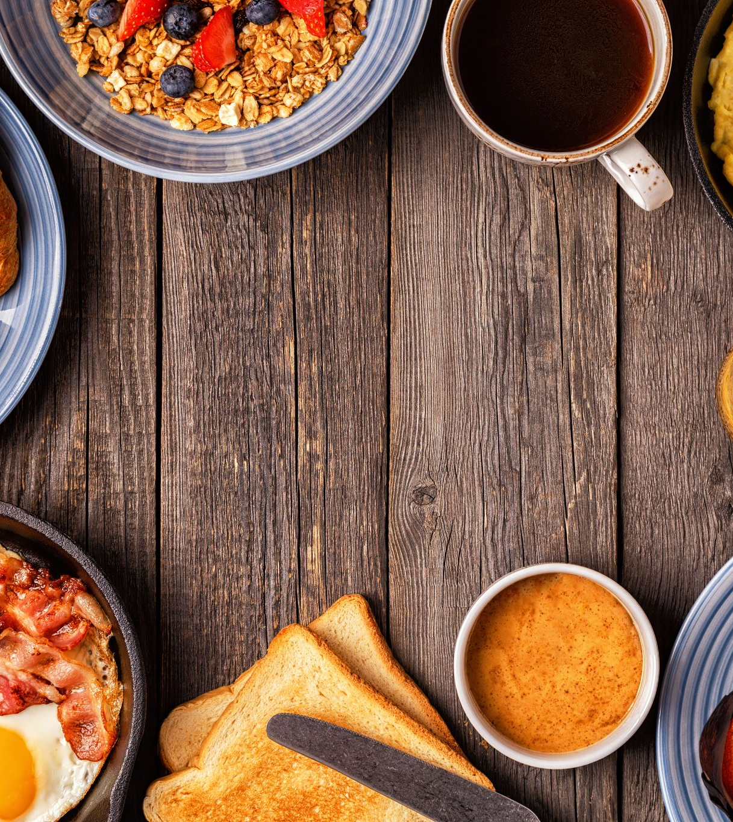
Investigation 1: Understanding Food Image Datasets
We're examining various food picture datasets, such as FOOD-101 and UEC-FOOD-256, used to train computers in food recognition.
Our summary table and sample images illustrate the contents of these datasets and their use in food recognition research.

Slide 9
Investigation 2: Understanding Model Hyperparameters
We're exploring various CNN settings, such as learning rate and batch size, to optimize performance.
Each dataset requires specific settings for accurate predictions, and we experiment to determine the best ones.
Methods like grid search or random search are used for fine-tuning these settings.

Slide 10
Investigation 3: CNNs for Food Image Recognition
We're investigating how CNNs, such as AlexNet, ResNet, VGGNet, and EfficientNet, assist computers in recognizing food images.
These models are adjusted to recognize the distinct features of various foods.
For instance, AlexNet was the first to win a significant image recognition competition, while ResNet enables deeper training.
VGGNet uses small filters for image classification, and EfficientNet scales to handle larger images with greater accuracy.
These CNN architectures significantly enhance food image recognition.

Slide 11
Investigation 4: Transfer Learning Strategies
We're exploring how transfer learning benefits food image classification (FIC).
For small datasets, we use feature extraction, utilizing existing model features and adding a new classifier.
For larger datasets, fine-tuning modifies some layers of the pre-trained model to better suit the new data.
However, determining which layers to adjust can be challenging.

Slide 12
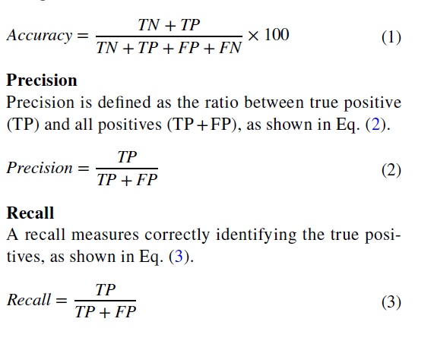
Investigation 5. What metrics are required to measure the performance of a model
We're studying metrics like accuracy, precision, and recall to measure how well food recognition models perform.
These metrics help assess the model's correctness and effectiveness in identifying different food items.
Notations used in formulas
TN stands for True Negative,
TP for True Positive,
FP for False Positive, and FN for False Negative.

Slide 13
Investigation 6. What are the challenges faced in classifying food images
We’re looking into challenges like overfitting, dataset variety, and adjusting settings that affect how accurately food images are classified.
These issues need solving to create better food recognition models.

Slide 14
Case Study: Food Image Analysis and Detection
Food identification is gaining importance in areas like nutrition management and self-service restaurants.
In this section, we showcase a case study on food image analysis using EfficientNet B0-B6 and food item detection using YOLOv5.

Slide 15
Food image analysis using EfficientNet B0‑B6
We examined models for food image classification using EfficientNet B0-B6.
With a dataset of 14 food classes, our trained models achieved accuracies between 87.7% and 89.57%.
However, certain food classes like apple_pie and bread_pudding were frequently misclassified due to their similar shapes.

Slide 16
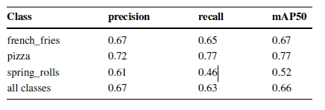
Object detection in food image using YOLOv5
We used YOLOv5 to detect food in images.
After training on a dataset containing 3 food types, we assessed its performance using metrics like recall, precision, and mAP.
The results are summarized in a table, sample images with labels are provided, and training and validation curves are illustrated in figures.

Slide 17
Conclusion and future aspects
A system that monitors nutrient intake and forecasts dietary needs is important for healthcare and dietary planning.
This review delves into the development and optimization of CNN models specifically designed for analyzing food images.
It examines previous studies to understand the challenges and solutions related to food image classification (FIC).
The review provides insights and recommendations based on these investigations.
It discusses various food image datasets, highlighting the number of different food types and total images included.
A case study is presented, showing how the EfficientNet model was trained using a food image dataset and achieved an accuracy of 86.5%.
Overall, this review aims to contribute to the development of food image-based dietary recommendation systems and guide future research in this area.

Slide 18


